Slide 1

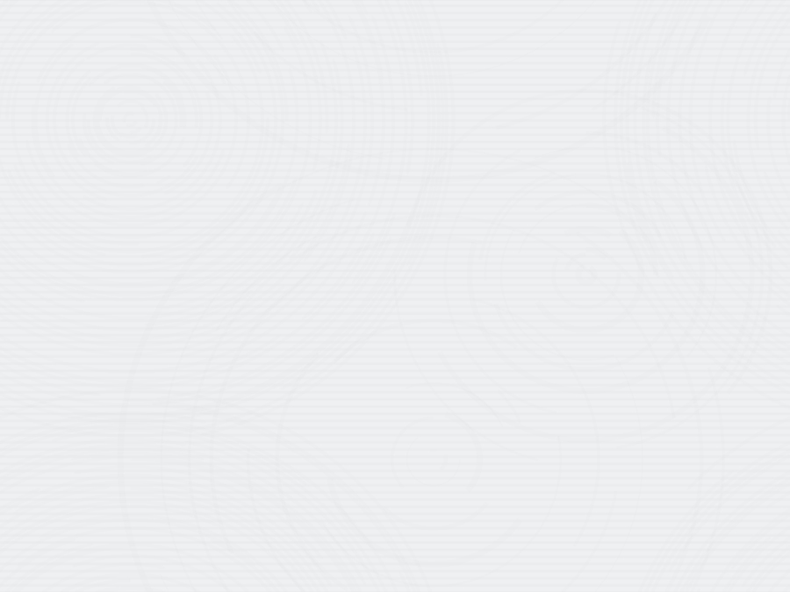
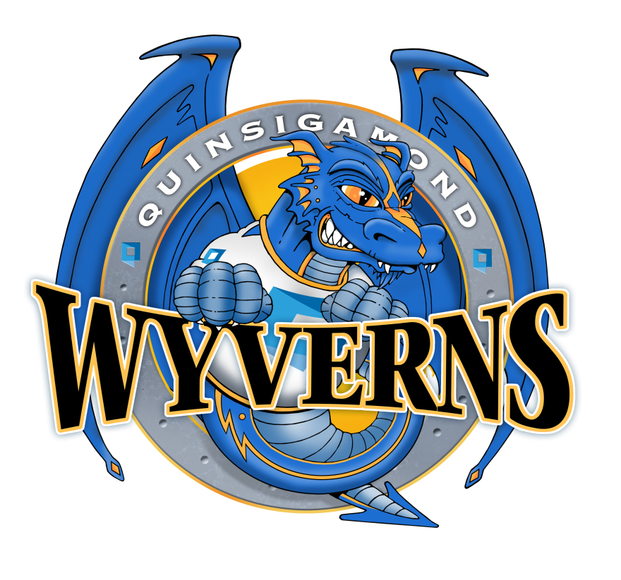

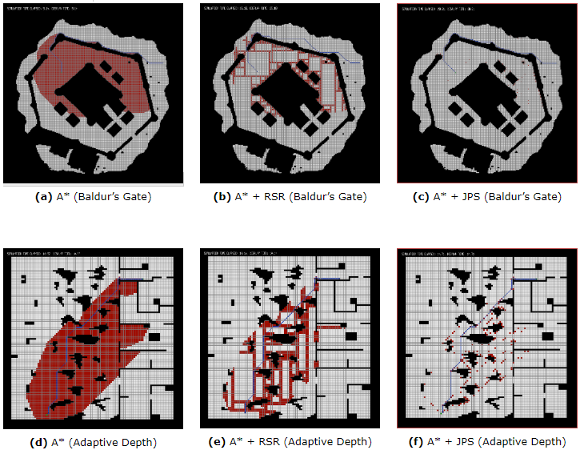
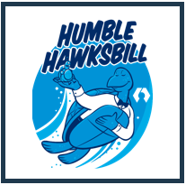
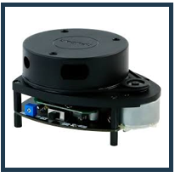
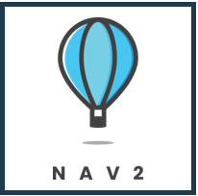
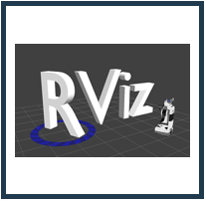
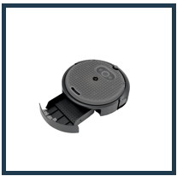
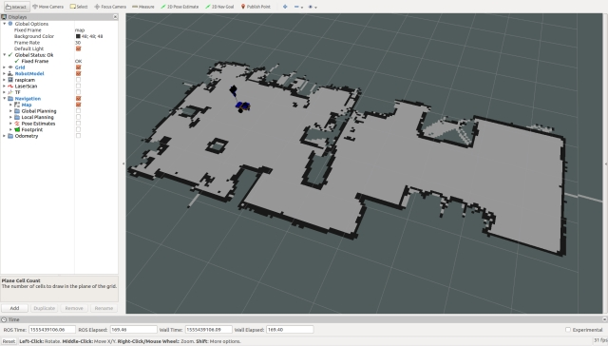
Wall Following and JPS+
Erick Ropi (Computer Science), Robert Pellegrino (Computer Science)
Advisor: Professor Hao Loi (Computer Science)
Introduction
Our main goal was to devise a faster and more comprehensive method for the Roomba to clean a room
Our methodology included the implementation of two algorithms: Wall Following and JPS+
Wall Following, as the name suggests, allows the robot to follow the path of a wall
JPS+ works as a pathing algorithm, calculating the optimal path between 2 designated points while still allowing for backtracking
Methodology
JPS+¹
The IRobot Create3 platform is an all-in-one robot development platform used to learn about ROS2. It was developed by IRobot, the company that makes Roomba, as an educational tool to teach students robotics.
ROS2, or Robot Operating System 2, is an operating system like Windows that is specifically made for robots. Is has all the features need to interact and program with ready-made robot systems like the Create3 Platform
RVIZ2, or ROS Virtualization is a powerful 3D Visualization tool used by ROS to visualize your robot and it’s sensors. We use this software along with our Lidar to map a room and keep track of our robot within the room!
JPS +, or “Jump Point Search +, is a highly optimized path finding algorithm used to find the shortest path between two points. It is built upon the widely known and used a*² pathfinding algorithm and is guaranteed to find the optimal path through a grid.
Normally, a pathfinding algorithm will look at every square around it to determine if it’s open and if it provides a closer path to it’s goal but instead, JPS+ searches the entire x and y axis next to a node to determine open ‘lanes’. This allows you to skip searching nodes that would otherwise be inefficient by looking past them entirely.
Challenge
Lidar Mapping
.
LIDAR or Light Detection and Ranging is a sensor that uses lasers to measure the distance of objects. It’s main purpose in our robot is to map out an entire room to give our robot a sense of where obstacles and walls are.
Using the Navigation 2 (NAV2) stack, we can use this LIDAR data to navigate our robot around a room automatically, avoiding obstacles while maintaining a sense of location.
Conclusion
We believe that using Wall Follow alongside JPS+ will lead to increased efficiency in the robot’s cleaning method
A typical Roomba cleaning robot uses a random algorithm, cleaning until it hits something and turns,
so you never know if the full room will ever be clean.
Using our algorithms the Roomba will clean in a uniform and orderly method, ensuring entire room coverage in less time
Wall Following
Wall following does exactly what it’s name suggests. It travels along a wall, following it, until it reaches a set destination. Our Wall Following algorithm was built from the ground up using the LIDAR detector to maintain a set distance from a wall to the left of the robot. It’s able to continue maintaining this distance all while avoiding obstacles.
Our robot does an initial spin to double check that it’s not already near a wall, drives forwards to find a wall, then rotates to become even with the wall it finds.
References
1. JPS+ - Steve Rabin et al, An Extreme A* Speed Optimization for Static Uniform Cost Grids, 2019
2. A* - Nils Nilsson et al, A Formal Basis for the Heuristic Determination of Minimum Cost Path, 1986

